Slide 1
Sequencing Genes & Genomes/The Transcriptome & RNA Silencing

Slide 2
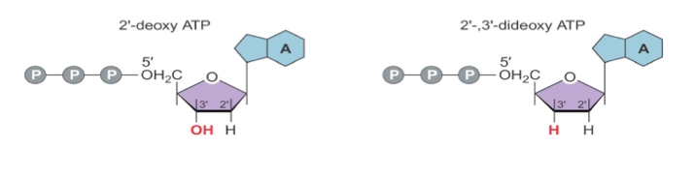
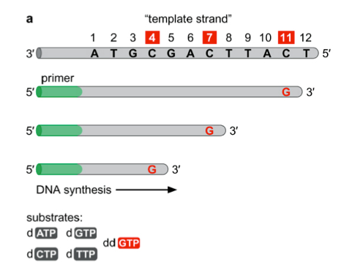
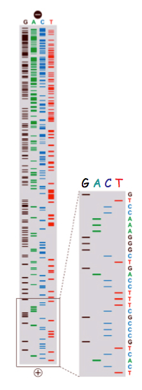
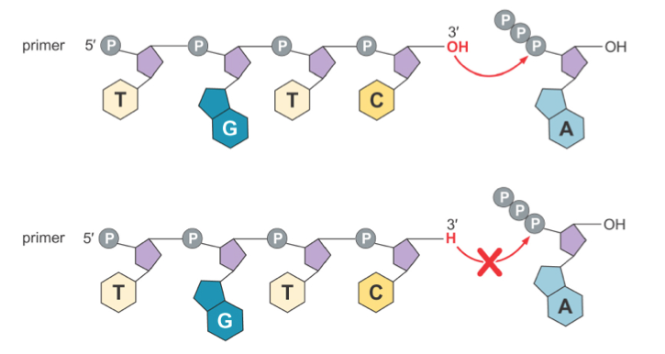
In dideoxynucleotides, not only is the 2’OH absent, but the 3’OH is absent as well
The absence of the 3’OH causes the nucleotide chain to terminate during DNA synthesis, as there is no reactive hydroxyl group to form a phosphodiester bond with an incoming 5’ phosphate
In each sequencing reaction, replace one deoxynucleotide with the dideoxynucleotide
Each reaction will have all of the possible lengths of sequence that end in that specific dideoxynucleotide
Run on a gel, and look at autoradiogram from each sequencing reaction to determine the sequence of the DNA

Slide 3
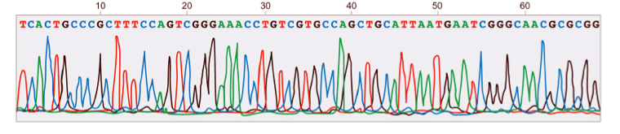
Each dideoxynucleotide has a different fluorophore attached
All dideoxynucleotides are added to the same sequencing reaction
Instead of typical gel electrophoresis, the reaction is run on a gel column called a “Sequenator”
This can read the fluorescence as the DNA emerges

Slide 4
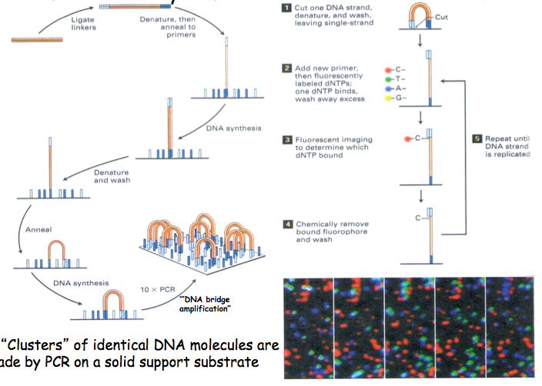
PCR amplification of target sequence in clusters, generates thousands of identical copies and strengthens the signal tremendously
Uses four different fluorescence tagged nucleotides, incorporation of nucleotides simultaneously detected in each cluster and the fluorescence images are captured
Produces fast, long sequences

Slide 5
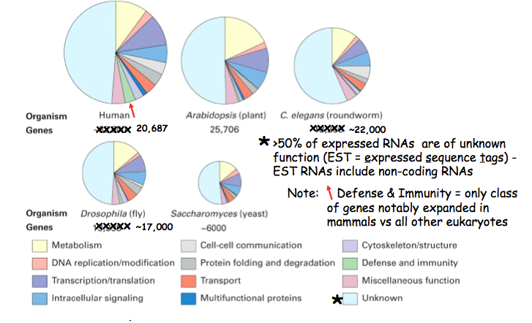
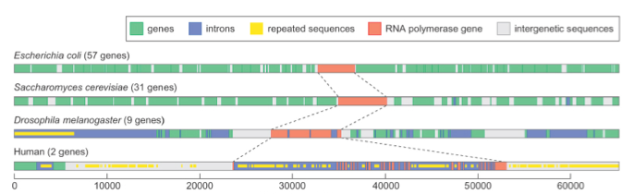
Genome size increases in relation to biological complexity in multicellular eukaryotes, but NOT the number of protein coding genes
Bacterial and yeast genomes have densely-packed protein coding genes, whereas gene density decreases with increase biological complexity and genome size in eukaryotes
Protein-coding genes in higher organisms are larger in size and have more exons and introns (larger)
Intergenic sequences increase with increased biological complexity, possibly due to increase number of regulatory elements required

Slide 6
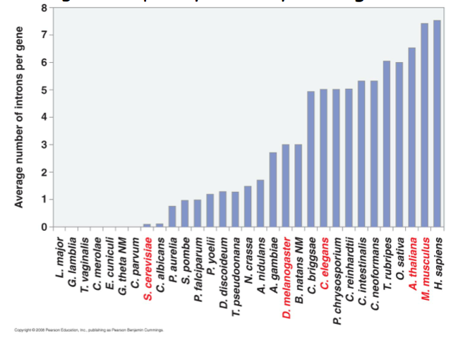
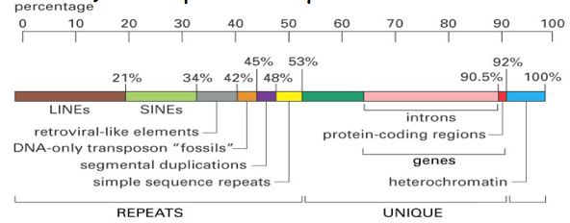
Most of the human genome is actually repeated sequences and other oddities, once known as “junk” DNA
Only ~1.5% of the human genome codes for proteins, and ~30% is transcribed into mRNA precursors
~50% of the genome is made up of families of repeated sequences
~10% of the genome is transposons, which are likely relics from past RNA viral infections - typically stable, but when mobilized can cause diseases such as hemophilia A
Thousands of pseudogenes, which are highly-mutated and non-functional disabled relics of genes that have premature stop codons or that frame-shifted
Interesting, ~20% of these are transcribed
The greater the complexity of the organism, the larger the fraction of DNA that is transcribed into non-coding RNA, which do possess regulatory functions

Slide 7
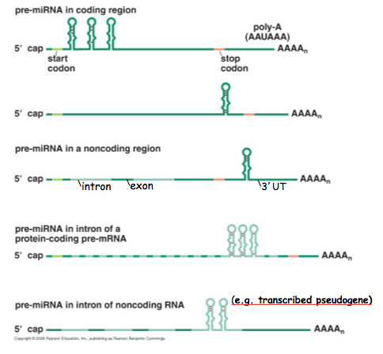
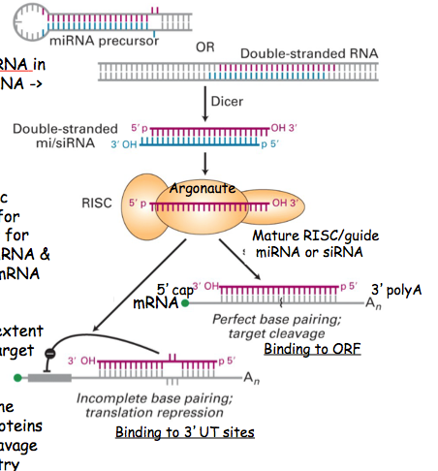
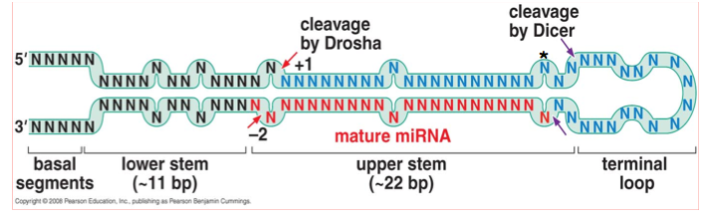
microRNA (miRNA) are processed from distinct hairpin structures called pre-miRNA, which are present in pre-mRNA and other transcripts
Drosha makes two cuts to release a 65-70 nucleotide long pre-miRNA containing the upper stem and terminal loop
The pre-miRNA is then exported into the cytosol for processing by Dicer, which creates a 21-23 base pair mature miRNA (RNAse III enzymes)
Single-stranded guide miRNA loaded into RISC complex
Base pairing targets mRNA and 1) mRNA cleavage is carried out by Argonaute protein with slicer endonuclease or 2) inhibition of protein synthesis (RISC associates with P bodies, contain de-capping and de-adenylating enzymes, endonucleases) which leads to mRNA degradation

Slide 8
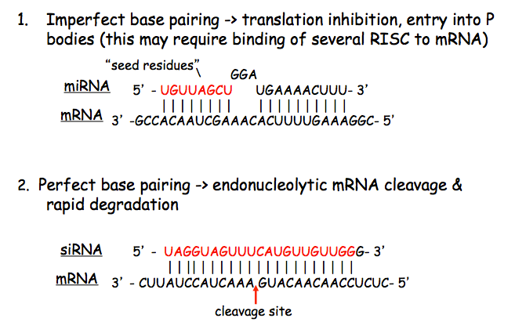
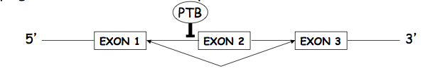
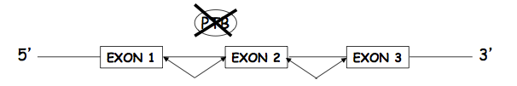
RNAi mechanism depends on extent of base pairing
Imperfect base pairing leads to translation inhibition, or entry into P bodies
Perfect base pairing leads to endonucleolytic mRNA cleavage & rapid degradation
Pyrimidine tract binding protein (PTB) is a regulatory splicing factor that controls alternative splicing by blocking 3’ splice sites (exon skipping)
miRNA miR-133 induction leads to inhibition of PTB translation, which changes the pattern of splicing and expression of different isoforms of proteins encoded by the gene PTB binds
miRNA “master regulators”

Slide 9
Comparative Genomics

Slide 10
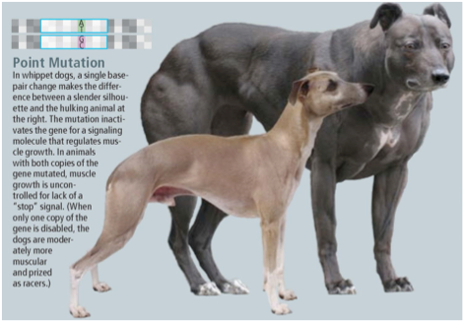
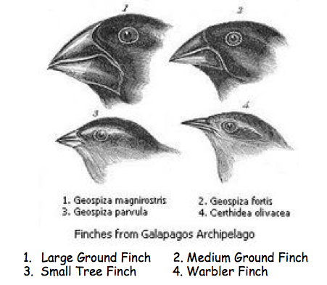
Variation is due to random mutations, which accumulate at a steady rate in genomes
Many are neutral changes, which can be used to determine the time since two species have diverged from one another in evolution
Higher rates of mutation identify important DNA sequences, generated by “positive selection”
Evolution works by 1) changes in gene structure or gene number or 2) changes in gene expression (regulatory factors)
New genes are rarely invented, just variations of existing genes
Missense mutation in the gene encoding myostatin (muscle growth) appeared in highly inbred dogs, creating slow muscle-bound dogs known as bully whippets (humans with a similar mutation also have aberrant muscle growth)
Darwin’s famous Galapagos finches are a classic example of variation causing changes in regulatory elements: slight changes in onset and expression of two genes responsible for beak size and shape (BMP and CaM)
Due to mutations in an isolated regulatory protein called “switch”

Slide 11
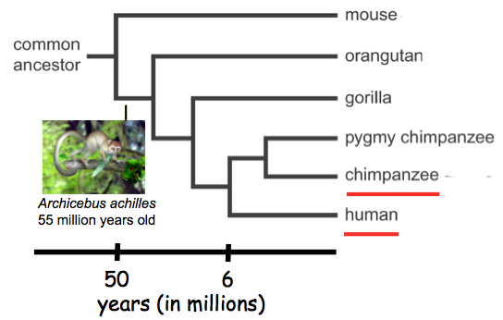
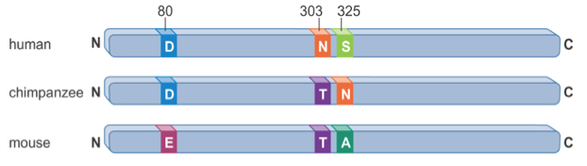
Comparative genomics are a powerful tool for understanding evolution and biological functions
Understanding how organisms have evolved by comparing their genes and entire genomes
Human and chimps diverges from a common ancestor ~6 million years ago, and are out closest living relatives
Chimps are ~98.8% genetically similar to humans and the differences likely result from random neutral genetic changes
Positive selection has maintained or conserved common essential proteins between chimps and humans
Gene loss and gene duplication responsible for most significant changes and differences
The FOXP2 transcription factor known to function in human speech
Associated with two nonconservative changes (Asp202, Ser325) and chimp and mice only differ by one change, (Asp vs. Ala325)
Overall, highly conserved, so mutations can highlight the importance of the transcription factor in speech production

Slide 12
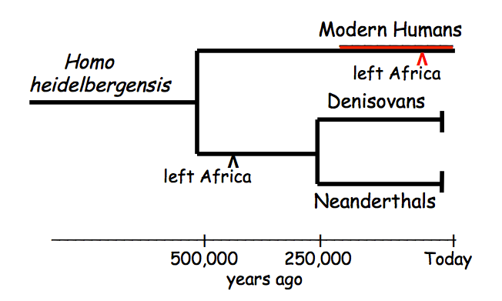
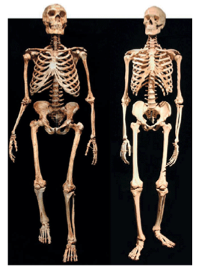
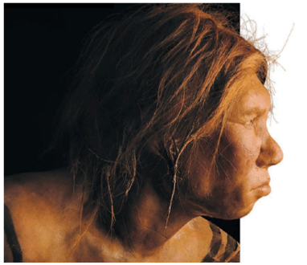
Human evolution over the past 500,000 years, started from Homo heidelbergensis, to the modern human, neanderthals, and denisovans
Ancestors migrated out of Africa about 400,000 years ago and 250,000 years ago the lineage split
Early, modern humans developed in Africa about 200,000 years ago
Only about 2-5,000 of these early humans survived and migrated out of Africa 60,000 years ago (arrived first in Europe, then in Asia)
Neanderthals had massive bony skulls, heavily muscled, compact bodies, and robust
Modern humans, neanderthals, and denisovan genomes are 99.5% identical and neanderthals and denisovans interbred with early modern humans
Early modern humans survived by tool-making and advanced cognitive ability

Slide 13
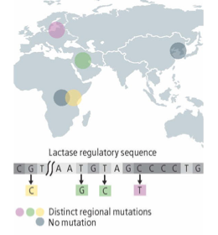
Lactose tolerance evolved from mutations that allowed transcription of the lactase gene to continue after childhood
These mutations have arisen independently around the world (at least four times in the last 9,000 years)
The mutations coincide with the earliest domestication of milk-producing herd animals in Europe, Asia, and the Middle East

